Slide 1

Brain cancer detection

Slide 2
Brain cancer detection
Supervised By
DR. Sabry M. Abdel-Moetty
TA. Esraa Ashraf

Slide 3
Supervised By
Team Member
Eslam Hany Mohamed Riad
Abd EL Rahman Ahmed Fouad Salman
Abd EL Rahman Reda Fathy Abu El-Yazid
Mahmoud Morsy Mahmoud Morsy
Abd El Rahman Ahmed Mohamed
Khaled Hesham Mohamed Rawdt
Omar Mohamed Shaban Ahmed
DR. Sabry M. Abdel-Moetty
TA. Esraa Ashraf
Brain cancer detection

Slide 4
Team Member
Eslam Hany Mohamed Riad
Abd EL Rahman Ahmed Fouad Salman
Abd EL Rahman Reda Fathy Abu El-Yazid
Mahmoud Morsy Mahmoud Morsy
Abd El Rahman Ahmed Mohamed
Khaled Hesham Mohamed Rawdt
Omar Mohamed Shaban Ahmed

Slide 5
Agenda
01
02
03
04
05
06
Introduction
Literature Review
Related Work
Introduction
1.1 Introduction to brain cancer
1.2 Objective
1.3 Problem Definition
1.4 Problem Solution
1.5 Challenges
Proposed System
Dataset
System implementation
07
08
09
Future Work
Tools
Conclusion

Slide 6
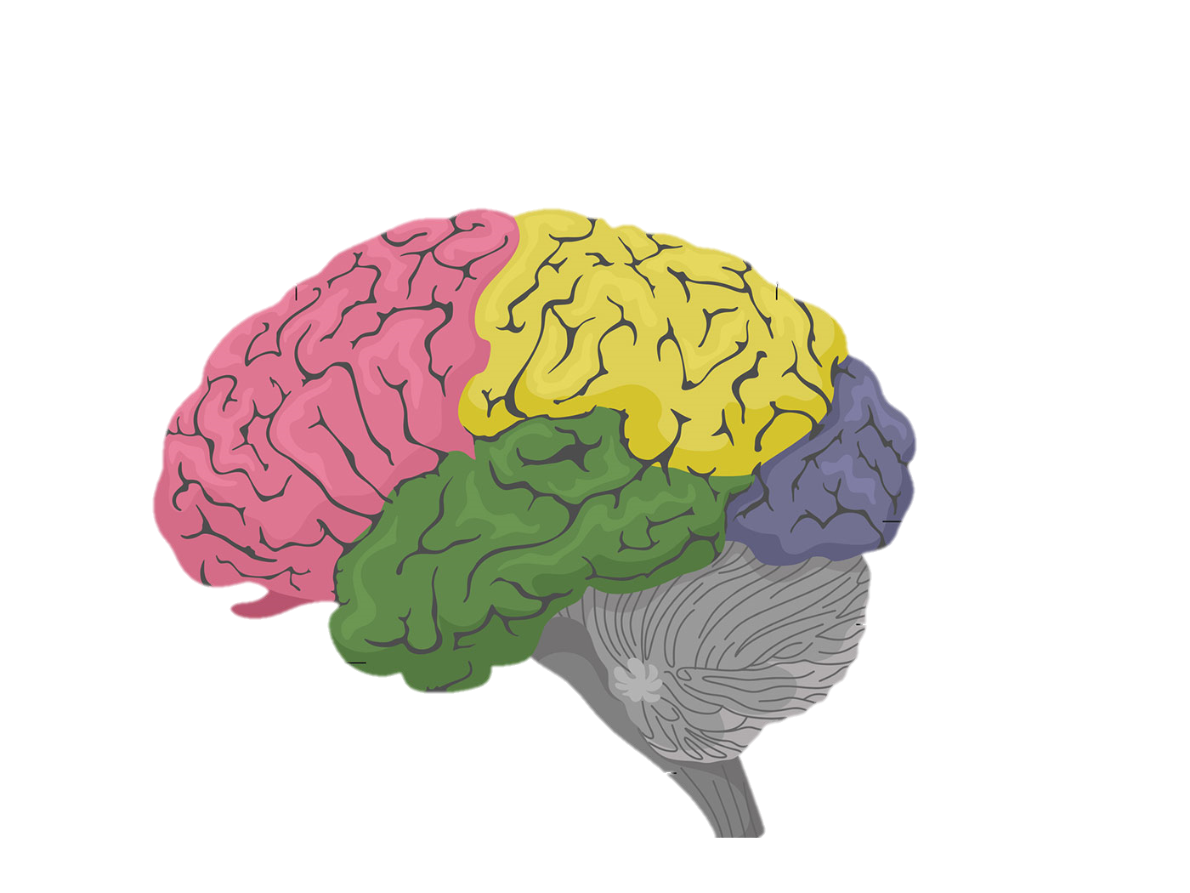
01
Introduction
1.1) Introduction
Introduction to brain
The brain is a complex organ that controls thought, memory, emotion, touch, motor skills, vision, breathing, temperature, hunger, and every process that regulates our body. Together, the brain and spinal cord that extends from it make up the central nervous system, or CNS.
1.1 Introduction to brain cancer
1.2 Objective
1.3 Problem Definition
1.4 Problem Solution
1.5 Challenges

Slide 7
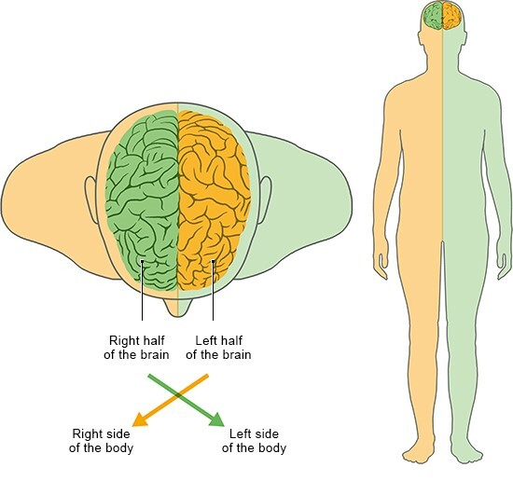
1.1) Introduction
Introduction to brain
The cerebral cortex is divided into two halves or hemispheres. The two halves join at a large, deep sulcus (the interhemispheric fissure, AKA the medial longitudinal fissure) that runs from the front of the head to the back. The right hemisphere controls the left side of the body, and the left half controls the right side of the body.
Introduction to brain
The brain is a complex organ that controls thought, memory, emotion, touch, motor skills, vision, breathing, temperature, hunger, and every process that regulates our body. Together, the brain and spinal cord that extends from it make up the central nervous system, or CNS.

Slide 8
1.1) Introduction
Introduction to brain
The cerebral cortex is divided into two halves or hemispheres. The two halves join at a large, deep sulcus (the interhemispheric fissure, AKA the medial longitudinal fissure) that runs from the front of the head to the back. The right hemisphere controls the left side of the body, and the left half controls the right side of the body.

Slide 9
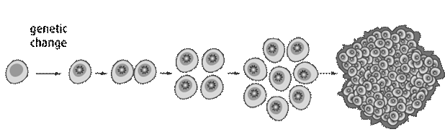
1.1) Introduction
Brain Tumor :
A brain tumor is a collection, or mass, of abnormal cells in your brain. Your skull, which encloses your brain, is very rigid. Any growth inside such a restricted space can cause problems.
Brain tumors can be :
Benign
Malignant
Factors that specify the tumor stage:
Where the tumor is located.
The size of the tumor.
Whether the cancer has spread to nearby lymph nodes.
Whether the cancer has spread to a different part of the body

Slide 10
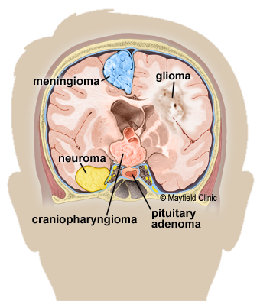
Types of Tumor:
There are over 120 different types of brain tumor.
But we will take about three types only in our project
glioma
meningioma
pituitary

Slide 11
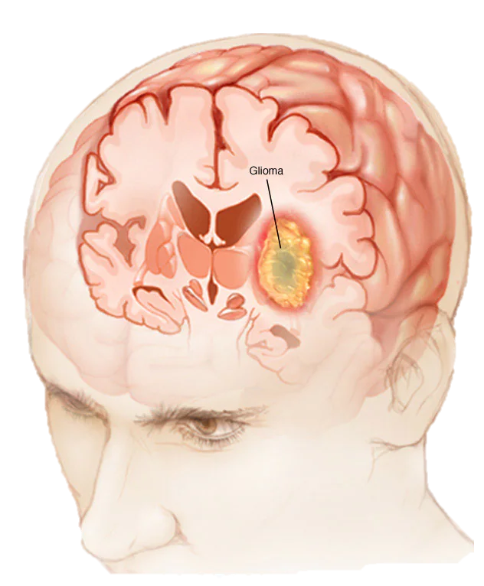
1. Glioma
Glioma is a increase of cells that begins inside the brain or spinal cord. The cells in a glioma appear just like healthy brain cells referred to as glial cells. Glial cells surround nerve cells and assist them function.
Symptoms
Memory loss.
Personality changes or irritability
Vision problems, such as blurred vision, double vision, or loss of peripheral vision.
Speech difficulties.
Seizures.
Symptoms also may depend on the type of glioma, its size, and how quickly it's growing.

Slide 12
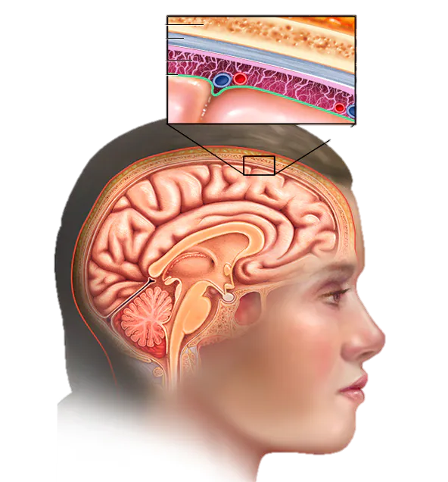
2. Meningioma
A meningioma is a tumor that arises from the meninges — the membranes that surround the brain and spinal cord. Although not technically a brain tumor, it is included in this category because it may compress or squeeze the adjacent brain, nerves and vessels.
SYMPTOMS
Changes in vision, such as seeing double or blurriness
Headaches
Hearing loss or ringing in the ears
Memory loss
Loss of smell
Seizures
Weakness in your arms or legs
Language difficulty

Slide 13
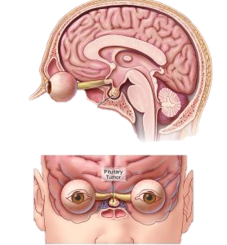
3. Pituitary
Pituitary tumors are unusual growths that develop in the pituitary gland. This gland is an organ about the size of a pea. It's located behind the nose at the base of the brain. Some of these tumors cause the pituitary gland to make too much of certain hormones that control important body functions. Others can cause the pituitary gland to make too little of those hormones.
Symptoms
Headache.
Eye problems due to pressure on the optic nerve, especially loss of side vision, also called peripheral vision, and double vision.
Pain in the face, sometimes including sinus pain or ear pain.
Drooping eyelid.
Seizures.
Nausea and vomiting

Slide 14
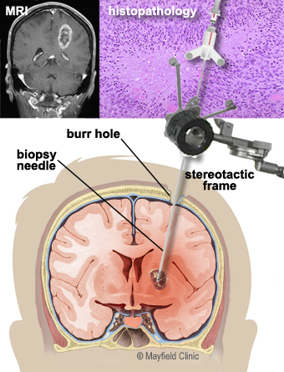
How to Know the type of tumor is present?
By using Biopsy
Biopsy is a procedure to remove a small amount of tumor cells to be examined by a pathologist under a microscope.
A biopsy can be taken as part of an open surgical procedure to remove the tumor or as a separate diagnostic procedure, known as a needle biopsy.

Slide 15
Stage of the tumor
Stage 0
Abnormal cells are present but have not spread to nearby tissue. Also called carcinoma in situ, or CIS. CIS is not cancer, but it may become cancer.
Stage 1 – 3
Cancer is present. The higher the number, the larger the cancer tumor and the more it has spread into nearby tissues
Stage 4
The cancer has spread to distant parts of the body.

Slide 16
Treatment for a brain tumor
Surgery
Radiation therapy
Is the most common treatment for brain tumors. The goal of surgery is to remove as much of the tumor as possible
Uses high-energy beams to kill tumor cells. Radiation therapy can be given before, during, or after surgery.
Chemotherapy
Targeted therapy
uses drugs to kill cancer cells. Chemotherapy can be given by mouth, through an IV, or directly into the brain.
a treatment that targets the tumor's specific genes, proteins, or the tissue environment that contributes to a tumor's growth and survival

Slide 17
The incidence of brain cancer in people in the last 4 years
2020
2021
2022
2023
2.3 per 100,000 people.
2.4 per 100,000 people
2.5 per 100,000 people
2.6 per 100,000 people

Slide 18
Incidence rate per 100,000 people according to age

Slide 19
1.2) Objective
The early detection of brain cancer to help save more lives we use machine learning algorithms to accelerate detection speed to help decrease the probability of going into a critical stage so we hopefully can decrease the death rate of brain cancer.
This helps the user(physician) by early detection, increasing the accuracy of detection and decreasing the error-prone of humans.

Slide 20
1.3) Problem Definition
Brain cancer is one of the most dangerous diseases that people face at the present time, due to its fast-spreading speed so the time factor is most crucial.
The scans provided to the doctor have quality issues (such as noise, resolution, contrast, brightness, etc.) which can affect the accuracy and the visibility of small tumors, and it will require the patient to provide other tests for better accuracy which will delay the early detection and the tumor may progress into a more critical stage than before.

Slide 21
1.4) Problem Solution
Using digital image processing (Image Preprocessing & Image Processing techniques) we can enhance the image, remove noise, sharpen the image and other filter to help improve the image quality for better analysis and accurate results.
Using feature extraction by collecting the unique parameters of the brain cancer to help point out tumors more efficiently.
Using machine learning to provide accurate results and speed up the process detection to provide early detection.
Applying these solutions will help provide better image quality, detection of small tumors and improve detection speed with accurate result hoping to decrease the death rates of brain cancer.

Slide 22
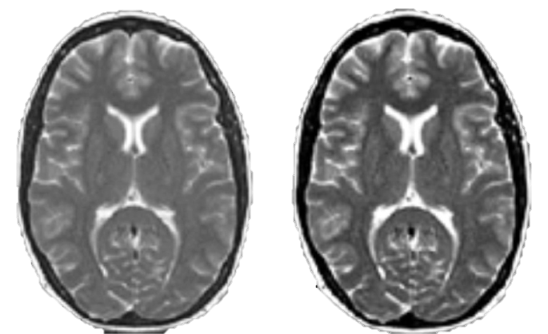
1.5) Challenges
1- Image quality
The quality of the image can be affected by factors such as noise , not gray image leading to low quality images that can compromise the accuracy of the system.
So, we use image enhancement to improve the quality of MRI images and reduce the impact of Noise

Slide 23
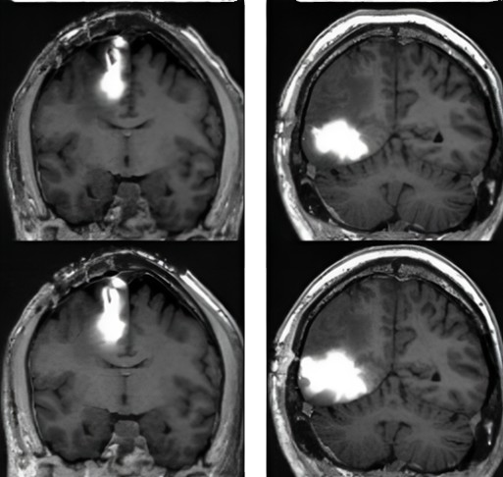
1.5) Challenges
2) Feature Extraction
The tumor can be found in different locations across the brain and the size can be different depending on each stage as we discussed before.
So, we use Feature Extraction algorithms used to accurately extract unique features of the MRI Images

Slide 24
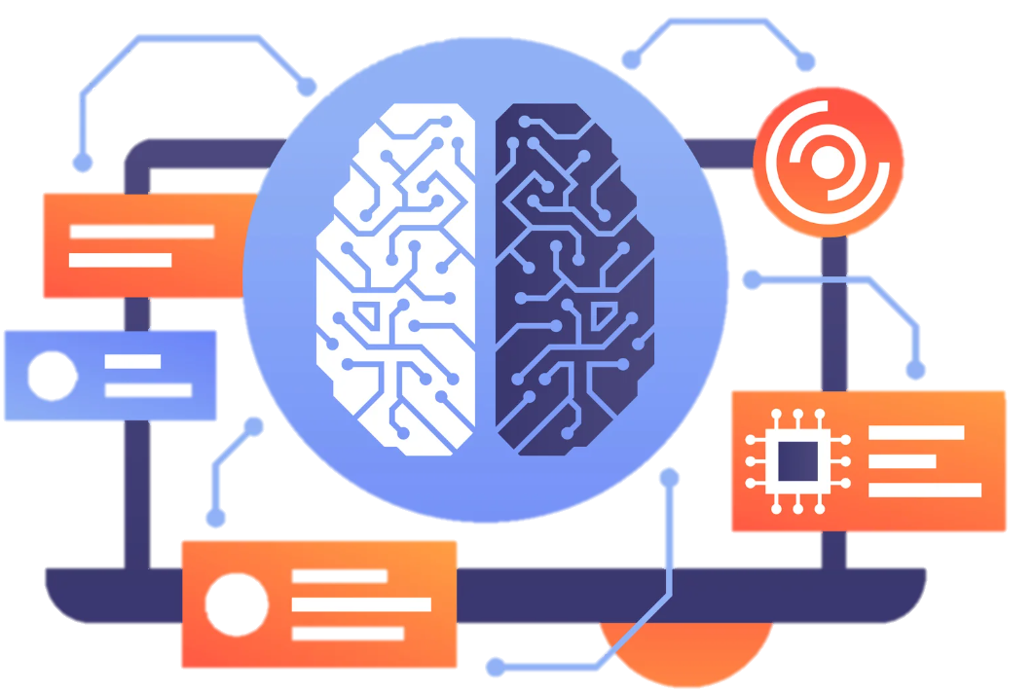
1.5) Challenges
3) Build Machine Learning Model
Data acquisition: Acquiring datasets for training and testing can be challenging, where datasets are not always available.
Model selection: The model selection can affect the accuracy, where some models may perform better with the dataset provided.
Data consistency: This affects the model accuracy greatly.

Slide 25
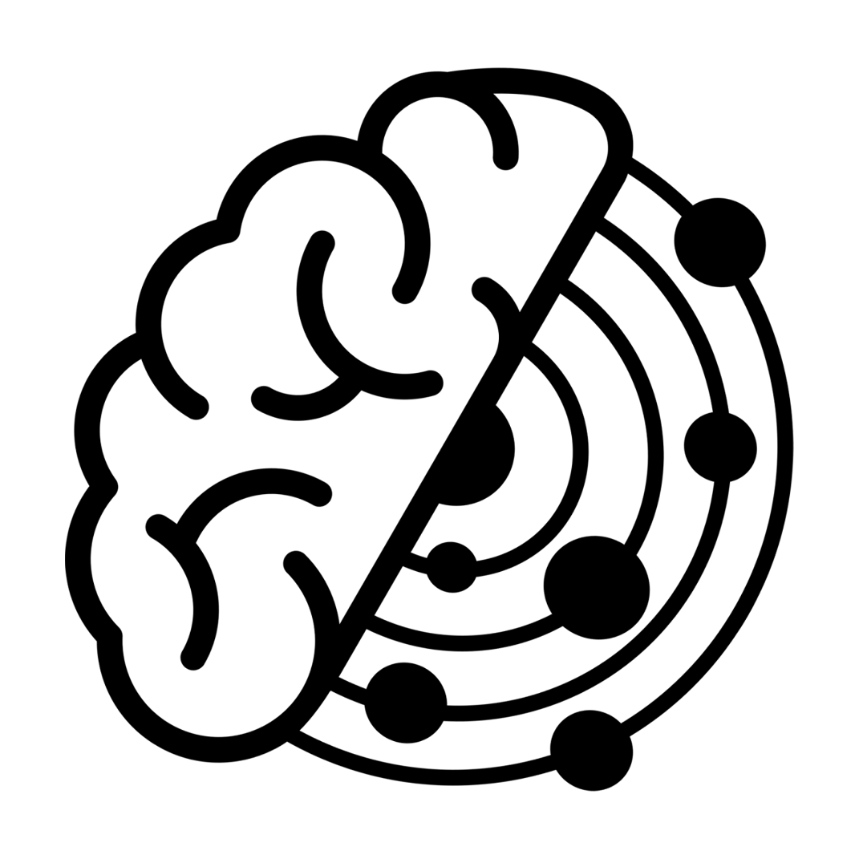

Logo

Slide 26
02
Literature Review
2.1 Image Processing
2.2 Feature Extraction
2.3 Machine Learning
2.4 Neural Network
2.5 Deep Learning

Slide 27
2.1) Image Processing
Image enhancement is typically applied as a pre-processing step before feature extraction.
The pre-processing step involves applying one or more image enhancement techniques to the MRI image to improve its quality.
Image preprocessing Techniques
Resize
Gray Scale Conversion
Histogram Equalization
Smoothing filters (Noise Removal)
Skull Stripping
Threshold

Slide 28
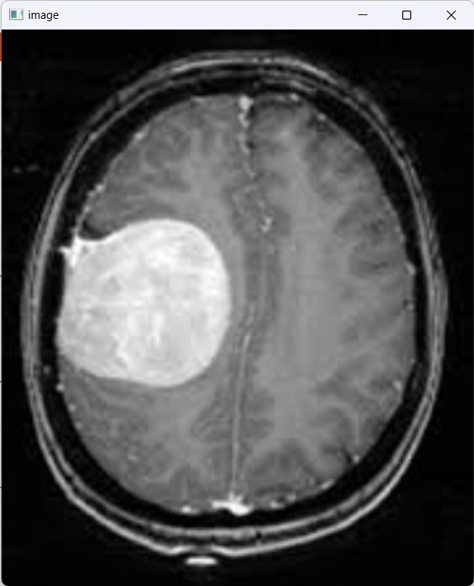
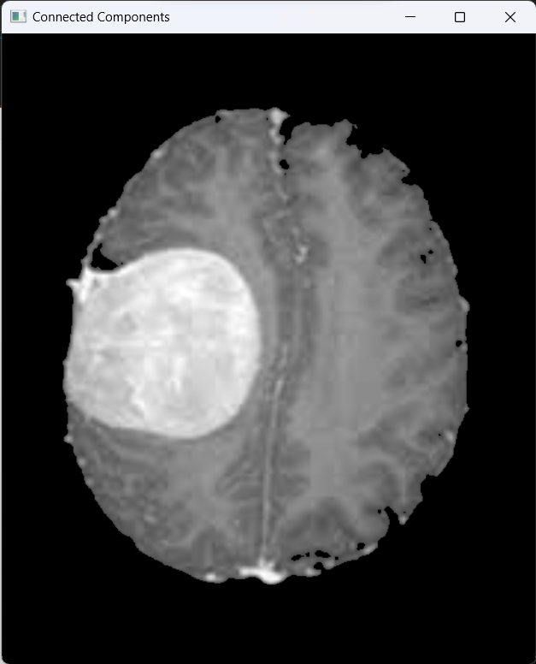
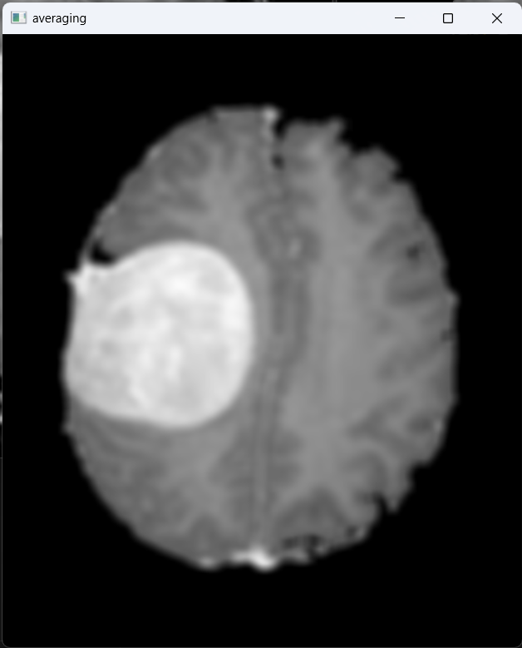
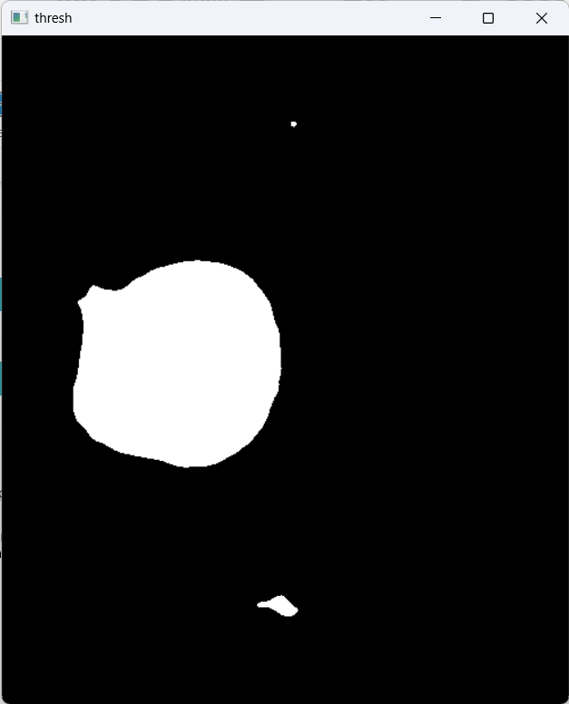
Example
Skull Stripping
Threshold
Scale Conversion
Averaging

Slide 29
2.2) Feature Extraction
The goal of feature extraction in MRI image analysis is to transform the raw image data into a set of meaningful and informative features that can be used to train machine learning to detect the tumor
Main Features
Color
Intensity
Texture
Shape
Context

Slide 30
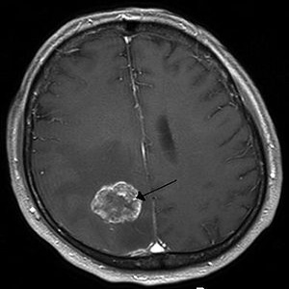
2.2) Feature Extraction
Color
Tumors in MRI images have a different color from the skull, tissues, and gray matter, due to the cells within a tumor can differ from normal brain cells in terms of their structure, density, and metabolic activity leading to variations in color.
Intensity
The intensity describes the brightness and darkness of the pixels in the image, where the tumor appears brighter in the MRI images.

Slide 31
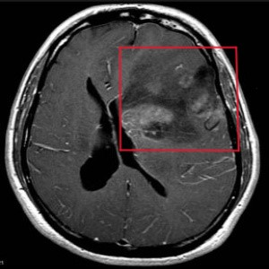
2.2) Feature Extraction
Texture
It is the visual pattern or surface characteristics present in the image; it describes the spatial arrangement of intensity variations.
A normal human brain has a uniform pattern, whereas an abnormal brain that has a tumor has a different pattern that can be identified through its deformation.

Slide 32
2.2) Feature Extraction
Shape
It the geometric properties of objects in the image, such as size and form, it can save the sizes of objects inside the image and what form they take.
Context
It is the surrounding information in the image, such as the scene or the background in which the object is in.

Slide 33
2.2) Feature Extraction
Intensity features:
Mean, Kurtosis, Standard Deviation.
Shape features:
Area, Orientation, Eccentricity, Convex Area.
Texture features:
ASM (Angular Second Moment), Contrast, Correlation, Dissimilarity, Energy, Homogeneity.

Slide 34
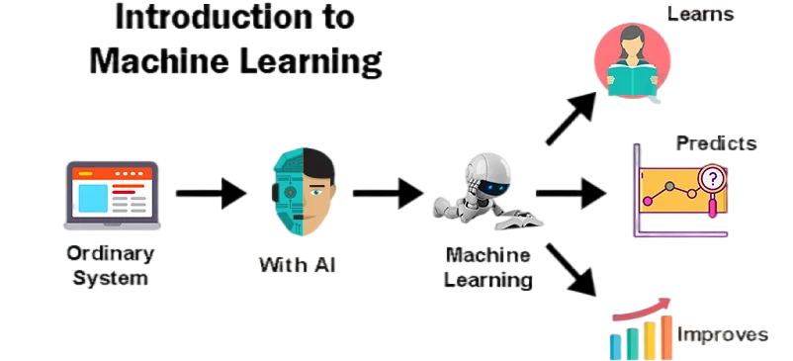
2.3) Machine Learning
Definition of Machine Learning
A branch of Artificial Intelligence (AI) that learn through an algorithm to predict possible outcomes.
Brief history
Machine learning was first introduced by Alan Turing in the 1940s. Turning developed a test after his name to test the machine ability to exhibit intelligent behavior that can be equivalent to a human.

Slide 35







ML Processes
Pre-Processing
Training
Tuning
Data Gathering
Choosing Model
Testing
Prediction

Slide 36


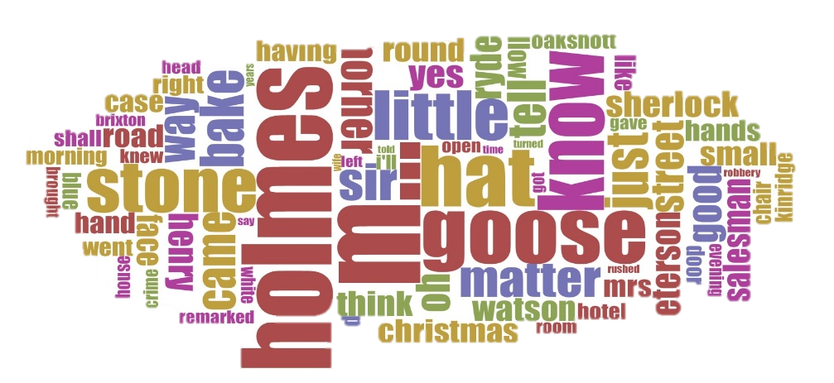
Training Data Types
The types of training data impact the algorithm.
There are two types of training data:-
1) Labeled data:-
It is data that has predefined tags.
Commonly used in supervised learning.
2) Unlabeled Data:-
It is raw data that has no tags.
Commonly used in unsupervised learning

Slide 37
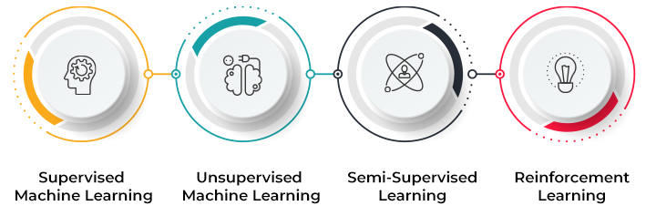
Types of Machine Learning

Slide 38




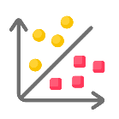




Types of Machine Learning
Supervised
Un-Supervised
Classification
Determine input data into different classes.
Clustering
Grouping unlabelled data together.
Regression
Plotting a line of best fit through the data points.
Association
Checks for the dependency of one data item on another data item and maps accordingly so that it can be more cost-effective.
Reinforcement
Rewarding
Approval of an introduced action.
Punishing
Disapproval of a wrong output

Slide 39
Types of Machine Learning
Common Algorithms used in supervised and unsupervised learning:
Linear regression
Logistic regression
Support vector machines (SVMs)
Decision trees
Random forests
Gradient boosting machines (GBMs)
Naive Bayes
K-means clustering
Hierarchical clustering
Gaussian mixture models (GMMs)
Principal component analysis (PCA)
t-distributed stochastic neighbor embedding (t-SNE)

Slide 40
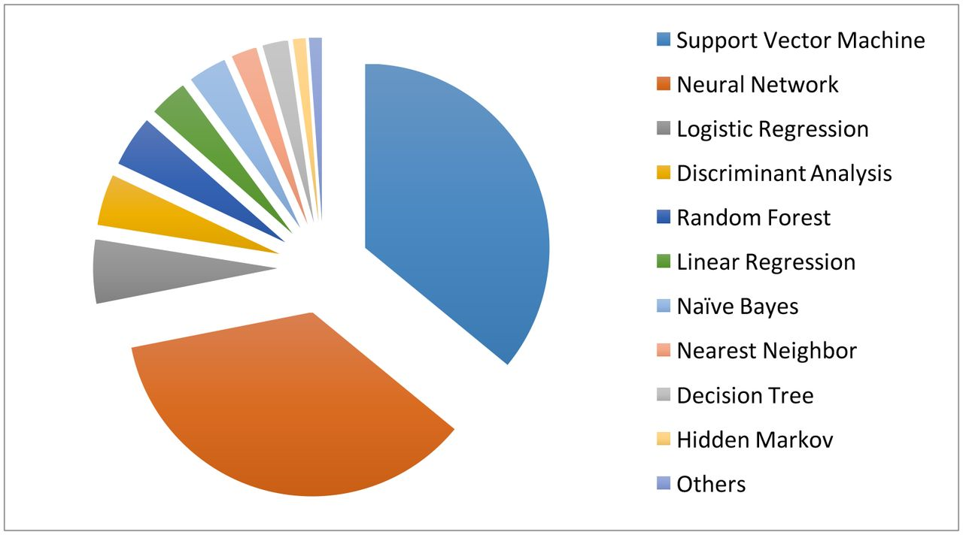
Most Common Algorithms used in Medical Field:

Slide 41
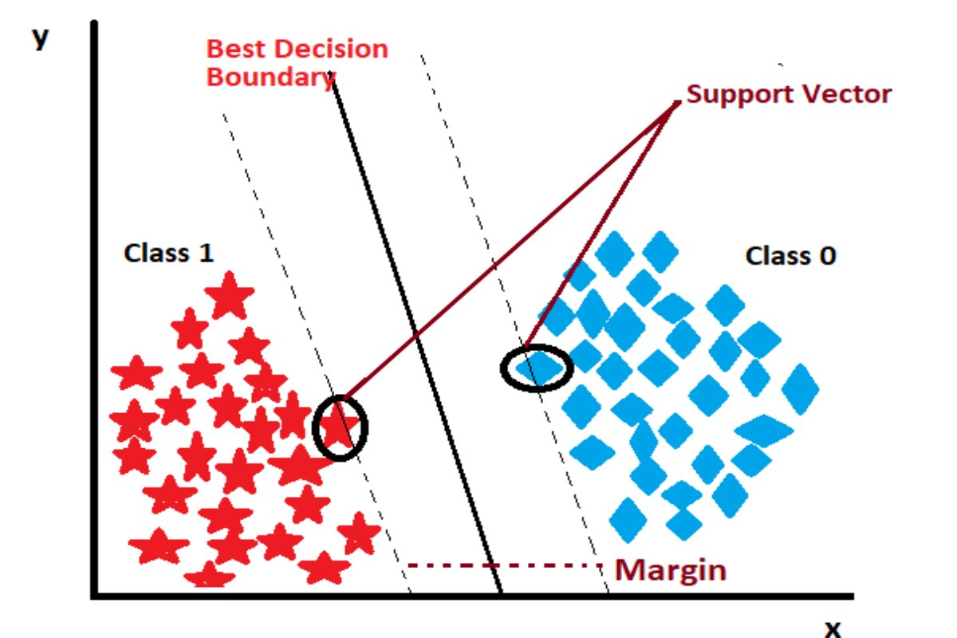
Common Medical Field Algorithms
Support Vector Machine (SVM):
SVM can be used for both classification and regression.
The working method is by finding a hyperplane in the input space that separates the data points into two classes.

Slide 42
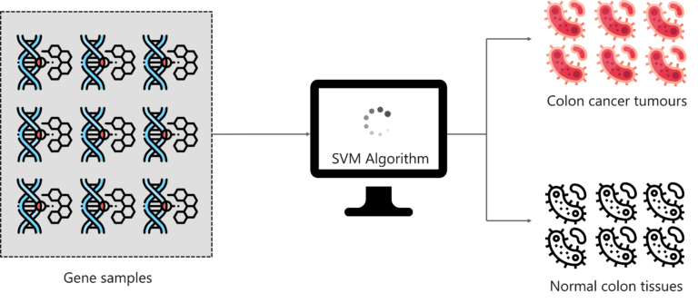
Common Medical Field Algorithms
Support Vector Machine (SVM):
SVM can be used to classify medical images, such as X-rays and MRI scans, and to predict the risk of a patient developing a disease.

Slide 43
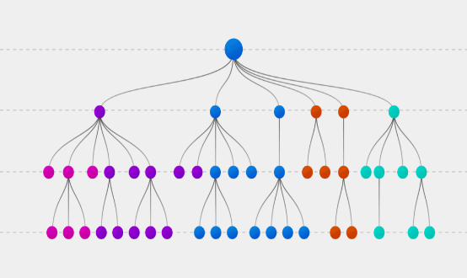
Common Medical Field Algorithms
Random forest:
Random forests are an ensemble learning algorithm that combines the predictions of multiple decision trees to produce a more accurate prediction. They are more accurate than individual decision trees and more robust to overfitting.

Slide 44
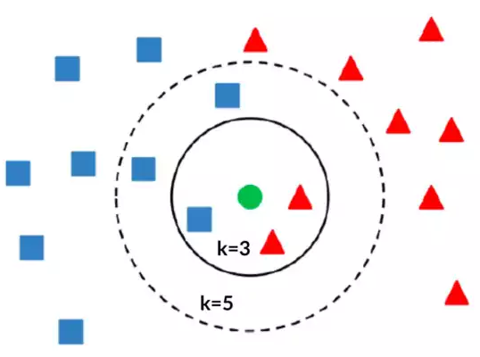
Common Medical Field Algorithms
K-nearest neighbors (KNN):
The K value is the main factor that decides on which the new data is classified into.
In this case if the K is chosen as 3, the new data is classified as classA (triangle).
if the K value is chosen as 5 the new data is classified as classB (rectangle).

Slide 45

2.4) Neural Network
Neural Network in human anatomy
Neural Network is a network of interconnected brain cells called neurons that are responsible for processing information in the human brain
The neurons communicate by sending electrical signals through this network.

Slide 46
2.4) Neural Network
Neural Network in Machine anatomy
In machine the idea of Artificial Neural Networks was inspired from the human brain Neural Network.
Hence, it was named.
The neurons in the machine model are called nodes these nodes are interconnected and organized in layers and each layer has a responsibility.
These responsibilities are:
Input
Computation
Output

Slide 47
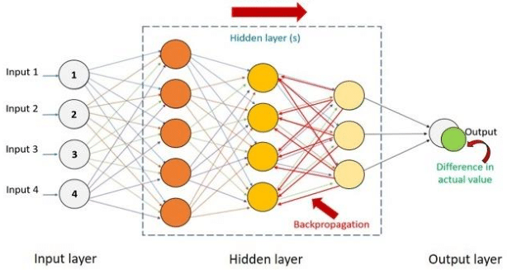
2.4) Neural Network
Algorithms
The algorithm is as the human brain neural network:
Nodes interconnected to each other, and each node does its function and then passes on to the node in the next layer.
The algorithms used are the same algorithms as machine learning where ANN is a subset of machine learning.

Slide 48
2.4) Neural Network
ANNs Types
Convolutional Neural Networks (CNNs):
Specialized for processing grid-like data such as images.
Utilize convolutional layers to automatically learn spatial hierarchies of features.
Commonly used in image classification, object detection, and image segmentation.

Slide 49
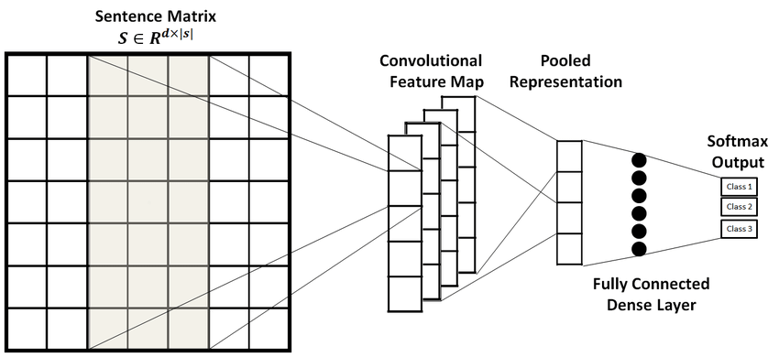
2.4) Neural Network
Convolutional Neural Networks (CNNs):

Slide 50
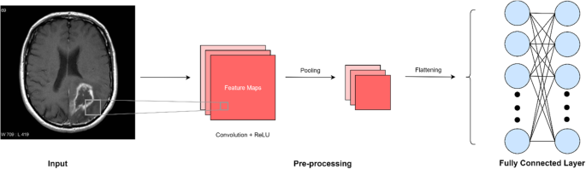
2.4) Neural Network
Applications
Medical: It can be used to detect cancer cells and analyze MRI pictures to provide detailed results.

Slide 51
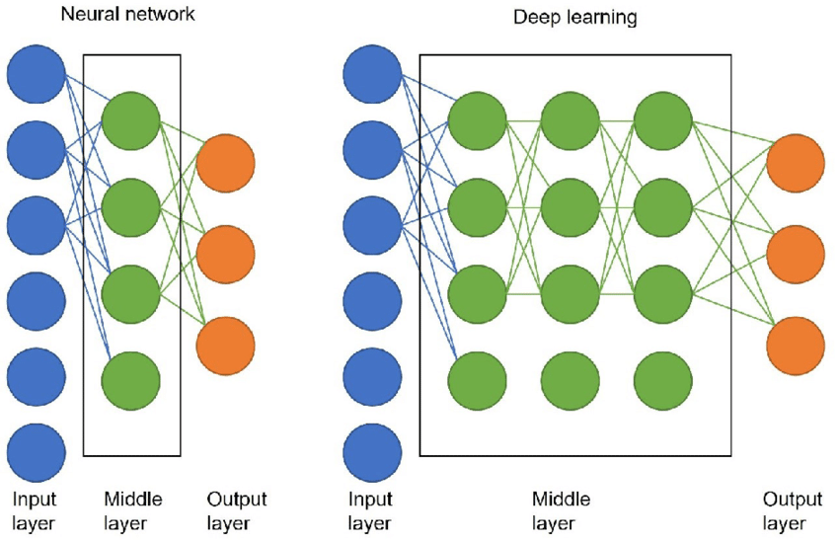
2.5) Deep Learning
Definition of Deep Learning
Deep learning is a neural network with three or more layers.
It can be considered the same as neural network but with more layer which skips the pre-processing of data and provides higher accuracy.

Slide 52
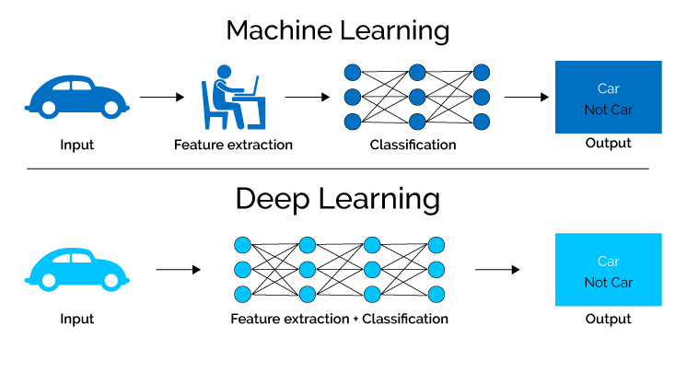
2.5) Deep Learning
Methodology & Algorithms
Since it is a subset of Artificial Neural Network, it has the same methods and Algorithms used in ANNs, but it has more layers, to improve the accuracy and recognize complex patterns.

Slide 53
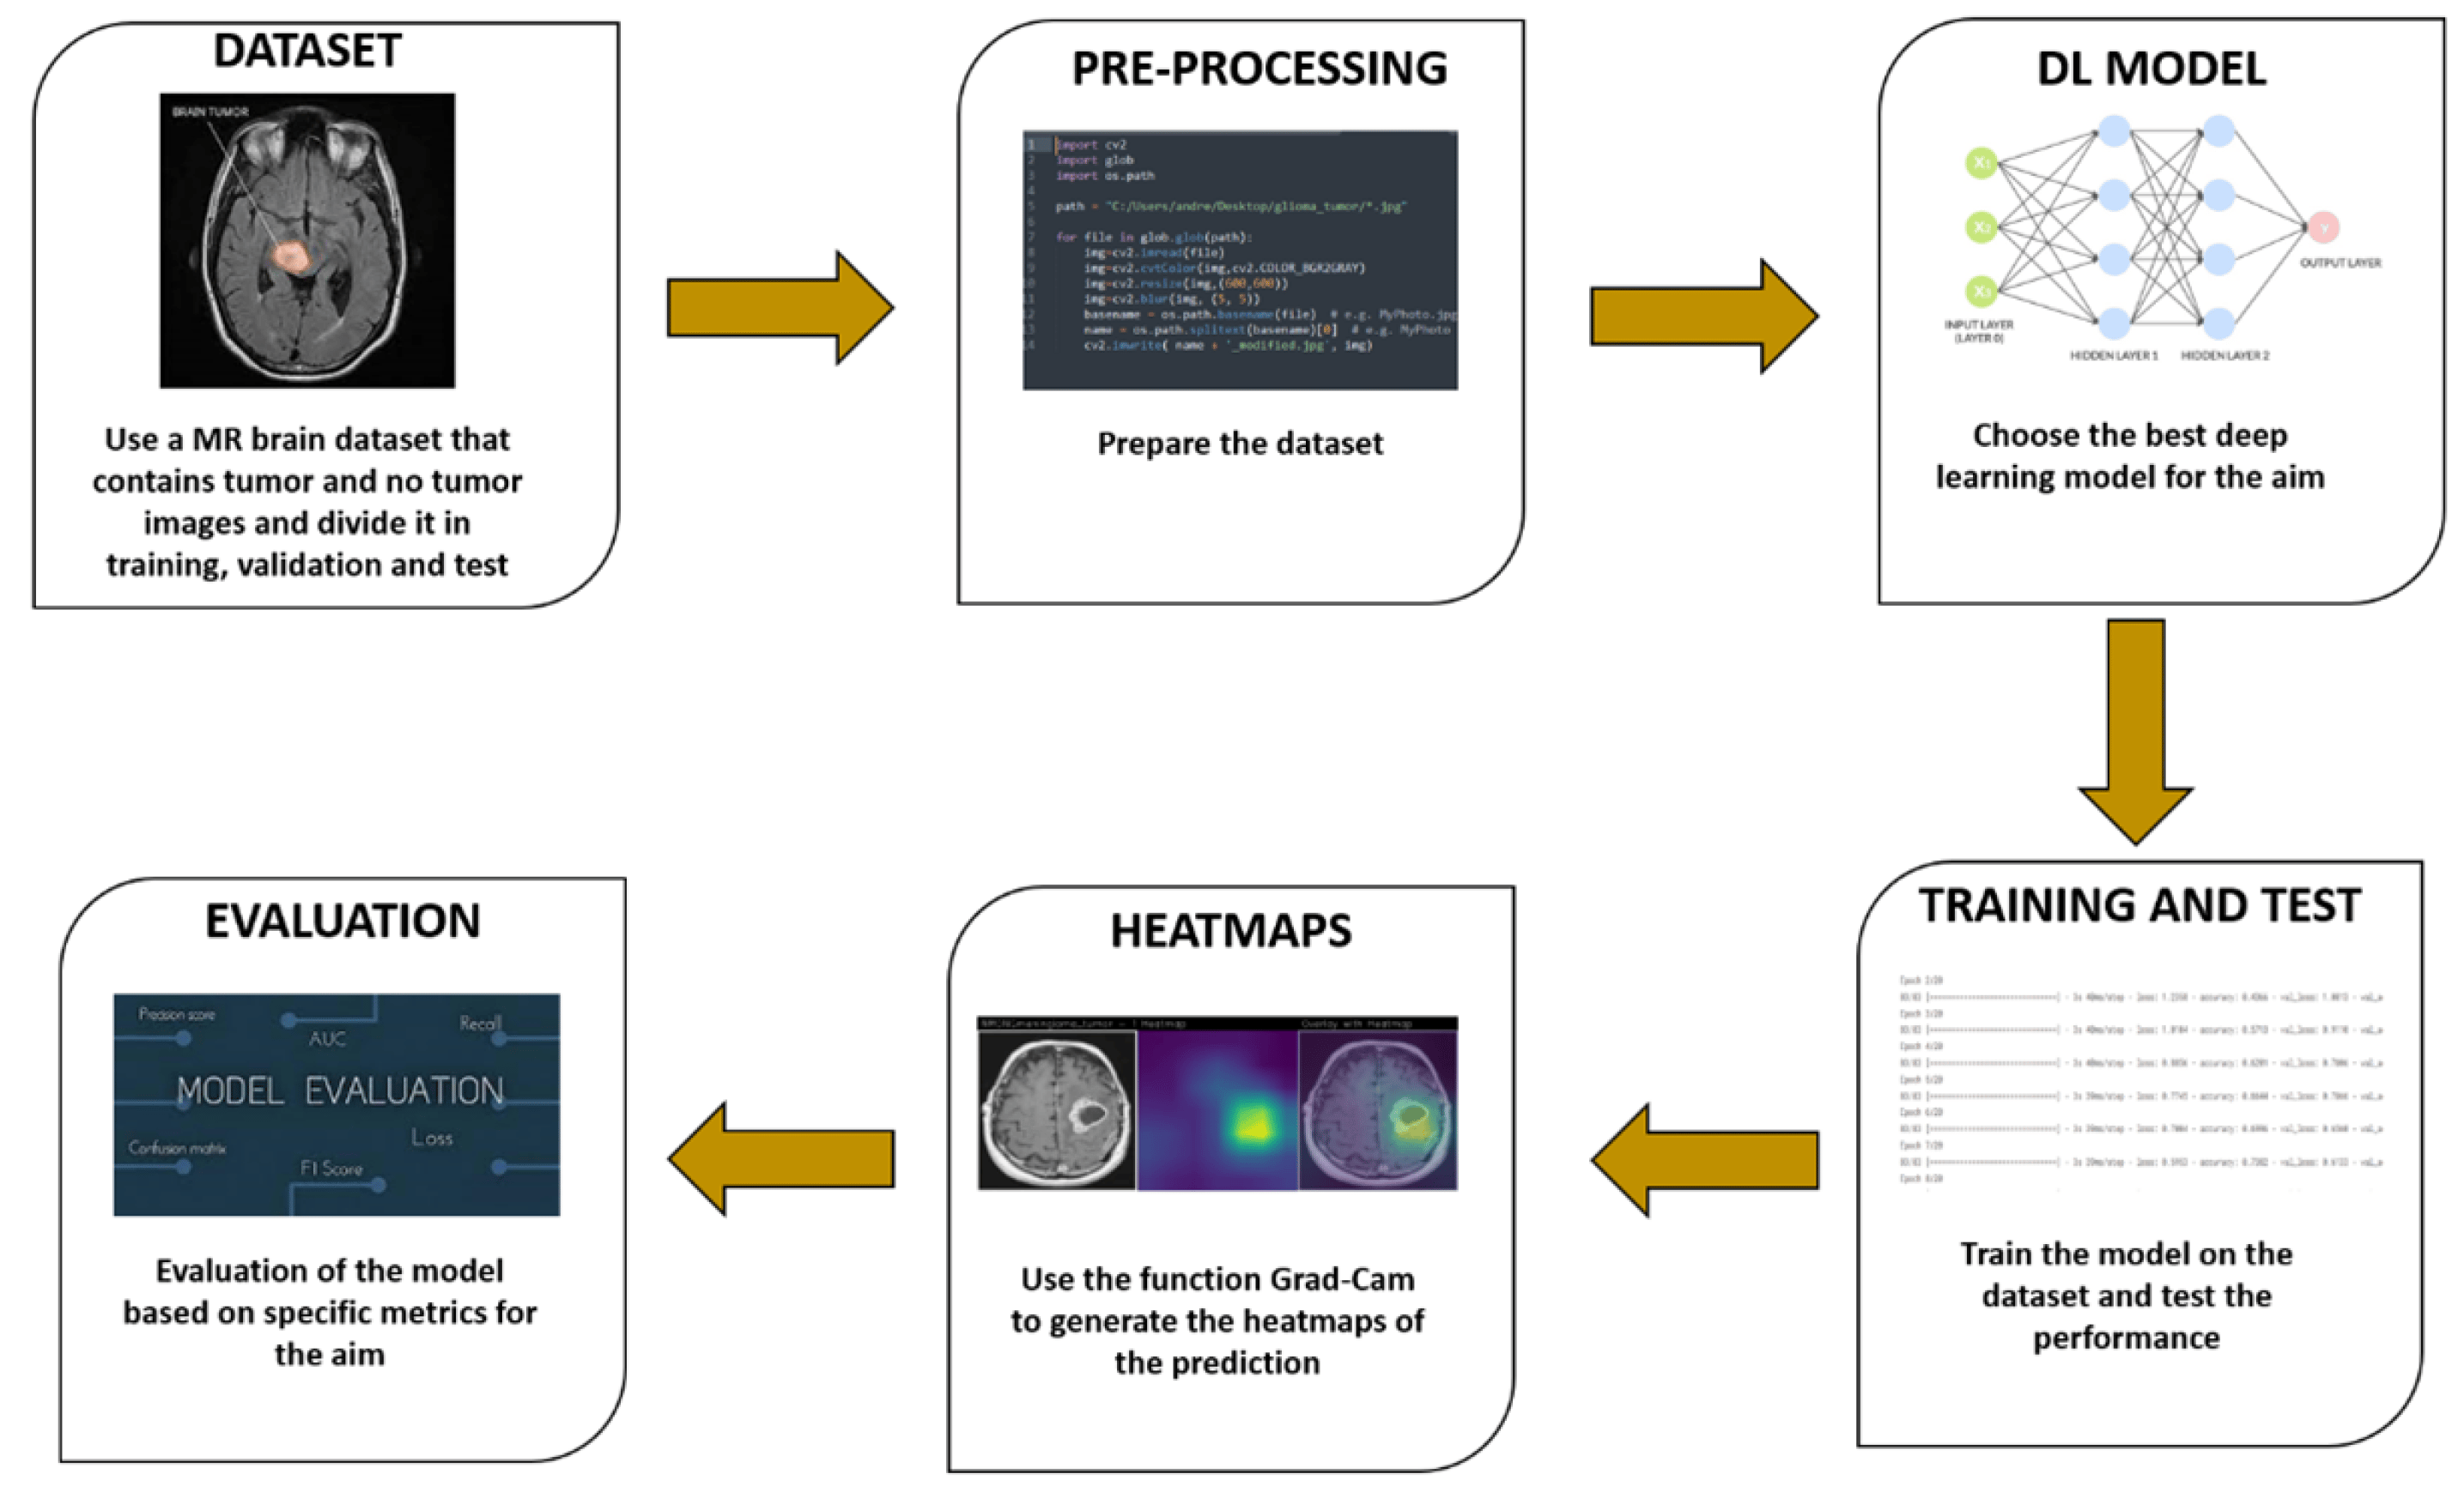
Methodology & Algorithms

Slide 54
2.5) Deep Learning
Deep Convolutional Networks:
Deep learning architectures built specifically for processing visual data.
Composed of multiple convolutional layers followed by pooling layers and fully connected layers.

Slide 55
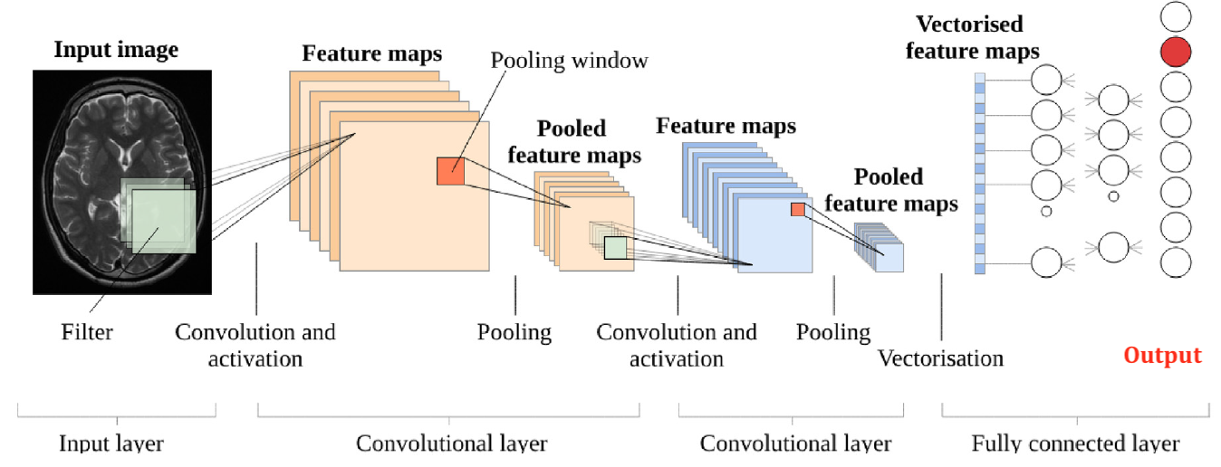
Deep Convolutional Networks

Slide 56
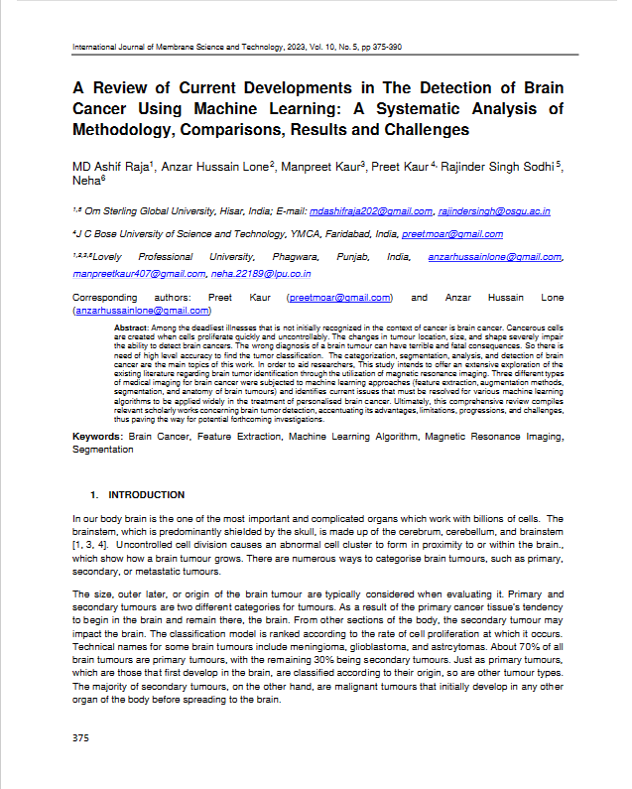
03
Related Work
3.1 Research papers
3.2 Our Work

Slide 57
Title:
A Review of Current Developments in The Detection of Brain Cancer Using Machine Learning: A Systematic Analysis of Methodology, Comparisons, Results and Challenges
Author date:
Oct 2023
Methodology:
Deep learning, machine learning

Slide 58
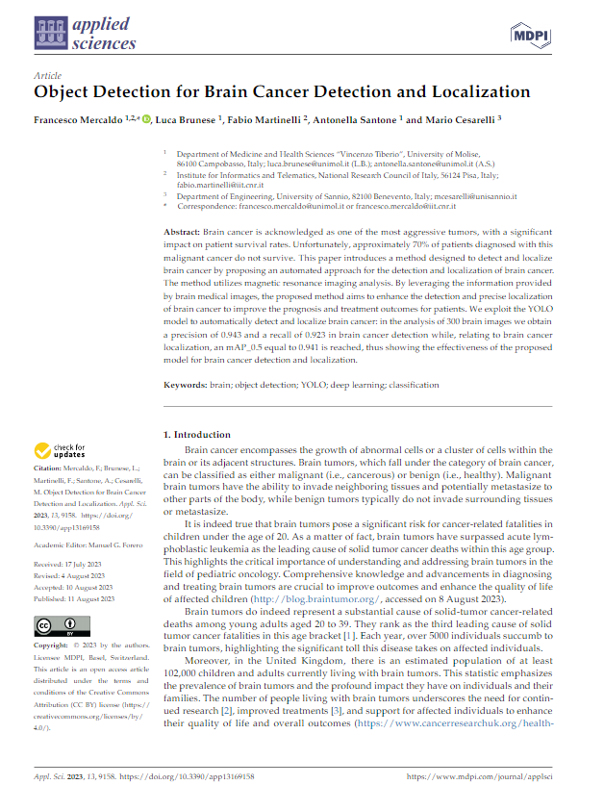

experimental result:
The results of the study showed that machine learning can be an effective tool for the detection of brain cancer.
Advantage:
Machine learning models can be trained on large amounts of data, which can make them more accurate than traditional methods of brain cancer detection
Disadvantage:
Machine learning models can be complex and difficult to interpret

Slide 59
Title:
Object Detection for brain cancer Detection and Localization
Author date:
Aug 2023
Methodology:
In this case uses YOLO ( You Only Look Once)

Slide 60
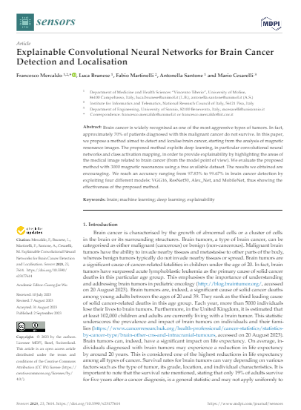
experimental result:
The using of function YOLO presents:
presents a collection of plots illustrating the performance of the proposed model for detecting and localizing brain cancer
Advantage:
Fast: YOLO is a real-time object detection algorithm,
Accurate: YOLO is a very accurate object detection algorithm
Easy to use: YOLO is a relatively easy to use object detection algorithm.
Disadvantage:
Requires a lot of training data
Can be sensitive to noise
Not always generalizable

Slide 61
Title:
Explainable Convolutional Neural Networks for Brain Cancer Detection and Localization
Author date:
September 2023
Methodology:
xCNNs
Experimental result:
The results we obtained are encouraging. We reach an accuracy ranging from 97.83% to 99.67% in brain cancer detection by exploiting four different models: VGG16, ResNet50, Alex_Net, and MobileNet, thus showing the effectiveness of the proposed method.

Slide 62
Advantage:
Increased trust and acceptance: xCNNs can increase trust and acceptance of AI models in medical applications by providing explanations for their decisions. This is important because doctors need to be able to understand how the model is making its predictions before they can trust it to make diagnoses
Disadvantage:
Increased computational complexity: xCNNs are often more computationally complex than standard CNNs, which can make them more difficult to train and deploy.
Potential for overfitting: xCNNs can be more prone to overfitting than standard CNNs, which can lead to poor performance on unseen data.

Slide 63
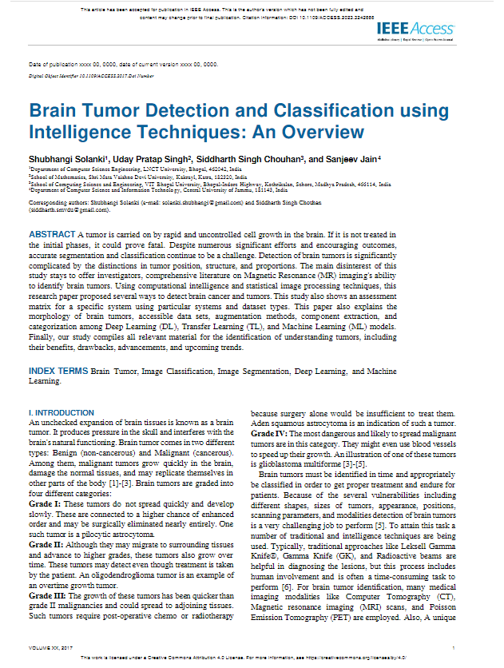
Title:
Brain Tumor Detection and Classification Using Intelligence Techniques: An Overview.
Author date:
Jan2023
Methodology:
Intelligence Techniques

Slide 64
Advantage:
Comprehensiveness
Focus on Techniques
Framework Proposal
Disadvantage:
Limited Originality
Lack of Detail on Proposed Framework.
Dependence on Source Quality

Slide 65
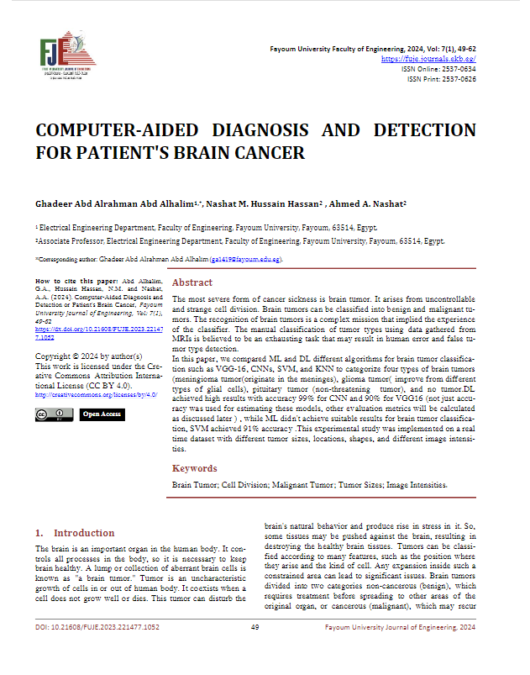
Title:
Computer-Aided Diagnosis and Detection or Patient's Brain Cancer.
Author date:
Jan2024
Methodology:
ML and DL
Experimental result:
Accuracy: The study reports the following accuracy results: CNN: 99% , VGG16: 90% , SVM: 91% (This is lower than the Deep Learning models)

Slide 66
Advantage:
High Accuracy
Reduced Human Error
Real-World Applicability
Disadvantage:
Limited ML Performance
Lack of Details on Evaluation Metrics

Slide 67
Title | Author date | Methodology | experimental result | Advantage | Disadvantage
Object Detection for brain cancer Detection and Localization | Aug 2023 | In this case uses YOLO ( You Only Look Once) | The using of function YOLO presents: • presents a collection of plots illustrating the performance of the proposed model for detecting and localizing brain cancer | •Fast: YOLO is a real-time object detection algorithm, Accurate: YOLO is a very accurate object detection algorithm •Easy to use: YOLO is a relatively easy to use object detection algorithm. | •Requires a lot of training data •Can be sensitive to noise •Not always generalizable

Slide 68
Title | Author date | Methodology | experimental result | Advantage | Disadvantage
A Review of Current Developments in The Detection of Brain Cancer Using Machine Learning: A Systematic Analysis of Methodology, Comparisons, Results and Challenges | Oct 2023 | Deep learning, machine learning | The results of the study showed that machine learning can be an effective tool for the detection of brain cancer. | Machine learning models can be trained on large amounts of data, which can make them more accurate than traditional methods of brain cancer detection | Machine learning models can be complex and difficult to interpret

Slide 69
Title | Author date | Methodology | experimental result | Advantage | Disadvantage
Explainable Convolutional Neural Networks for Brain Cancer Detection and Localization | September 2023 | xCNNs | The results we obtained are encouraging. We reach an accuracy ranging from 97.83% to 99.67% in brain cancer detection by exploiting four different models: VGG16, ResNet50, Alex_Net, and MobileNet, thus showing the effectiveness of the proposed method. | Increased trust and acceptance: xCNNs can increase trust and acceptance of AI models in medical applications by providing explanations for their decisions. This is important because doctors need to be able to understand how the model is making its predictions before they can trust it to make diagnoses. | Increased computational complexity: xCNNs are often more computationally complex than standard CNNs, which can make them more difficult to train and deploy. Potential for overfitting: xCNNs can be more prone to overfitting than standard CNNs, which can lead to poor performance on unseen data.

Slide 70
3.2) Our work
Title | experimental result | Methodology | Advantage
Brain Cancer Detection | Tell the user if he has tumor or not and if the has, he told the type of the tumor Tell the location of the tumor Tell the stage of the tumor Tell the treatment of the tumor Tell if the tumor malignant or benign | CNN & ML | High accuracy Fast predication Friendly UI

Slide 71
04
Proposed System
4.1 System Analysis
4.1.1 Use case
4.1.2 Activity Diagram
4.1.3 Sequence Diagram
4.2 Applications
4.2.1 Mobile Application
4.2.2 Web Application

Slide 72

4.1 System Analysis

Slide 73
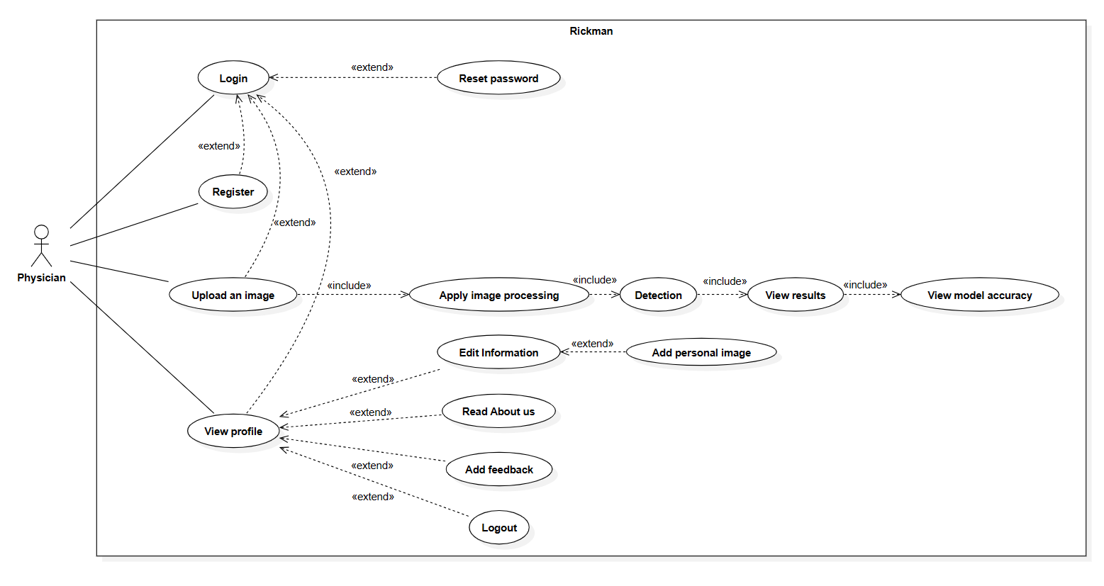
2.5) use case

Slide 74
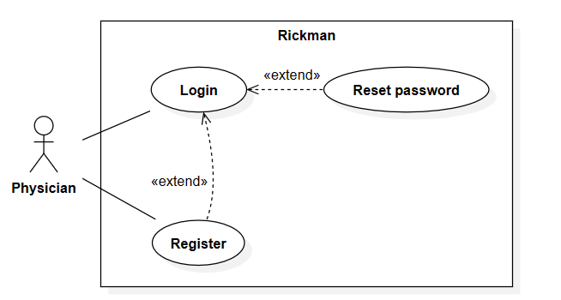
2.5) use case
Login / Register

Slide 75
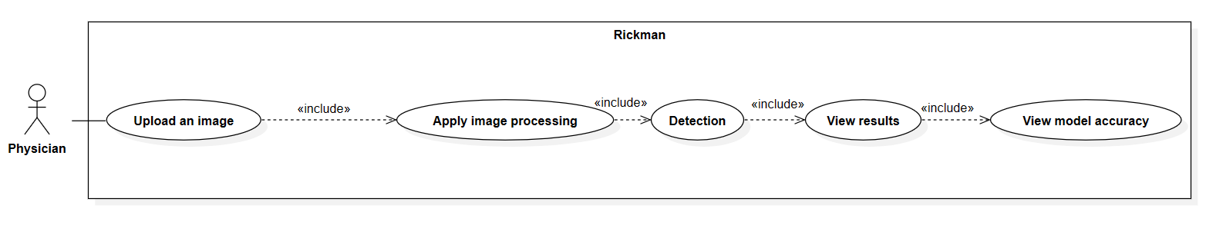
2.5) use case
Image processing diagram

Slide 76
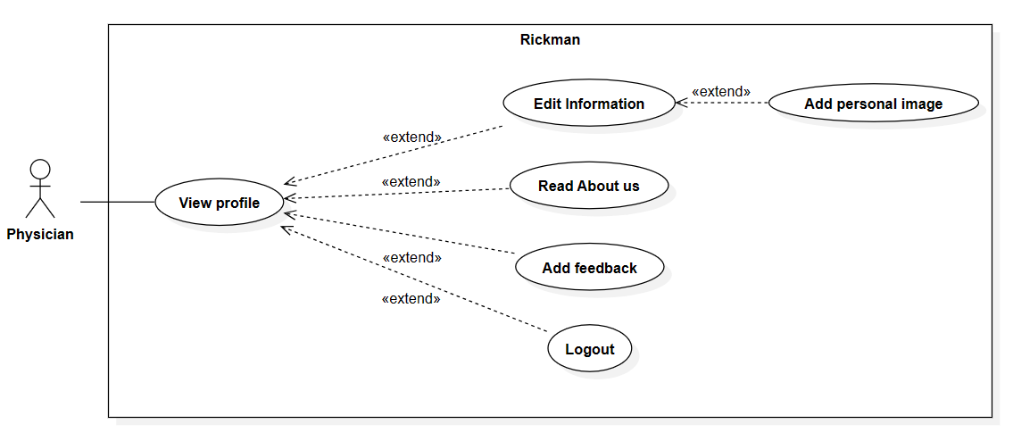
2.5) use case
Profile diagram

Slide 77
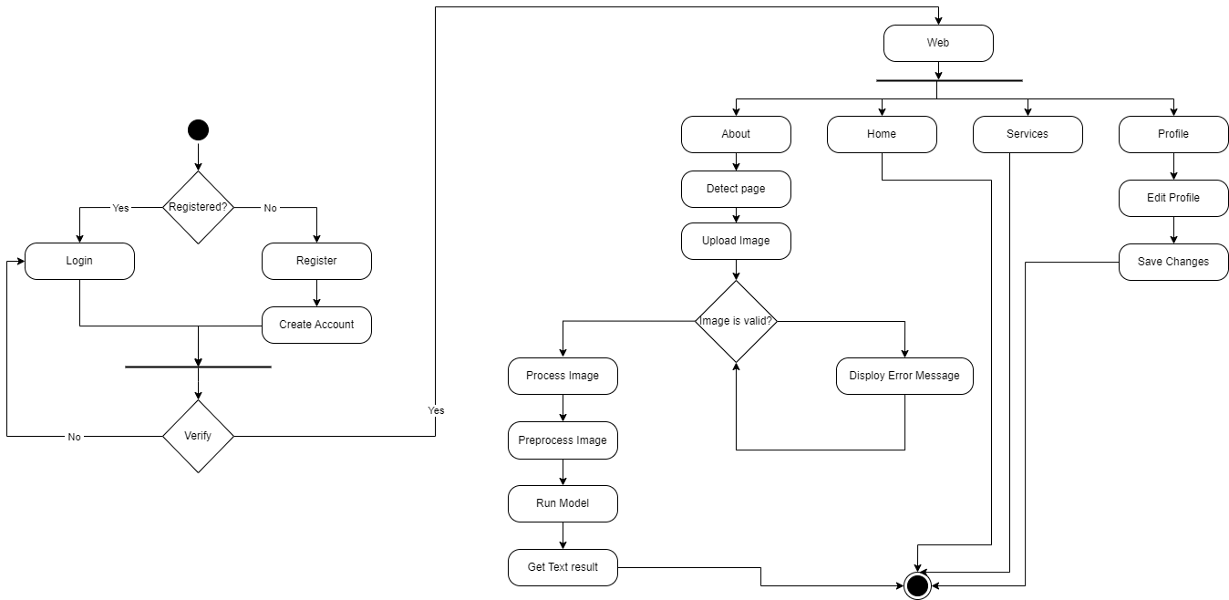
Activity diagram

Slide 81
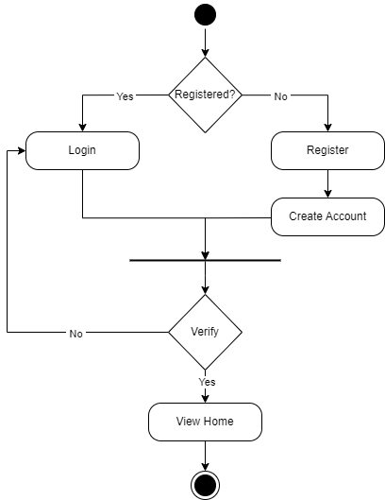
Activity diagram
Login / Register diagram

Slide 82
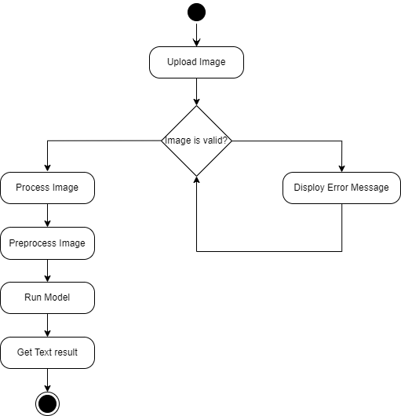
Activity diagram
Detect diagram

Slide 83
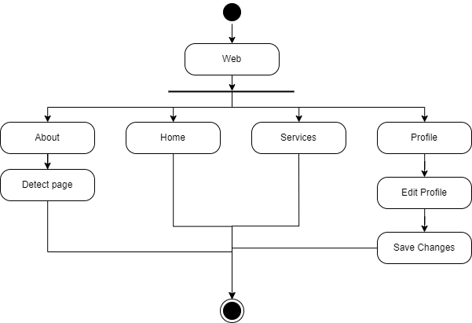
Activity diagram
Web diagram

Slide 84
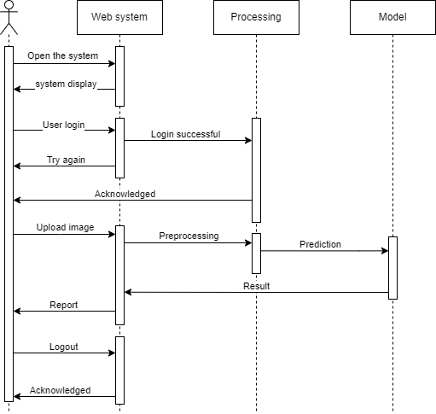
Sequence diagram

Slide 85
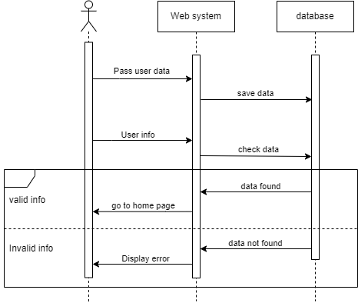
Login steps

Slide 86
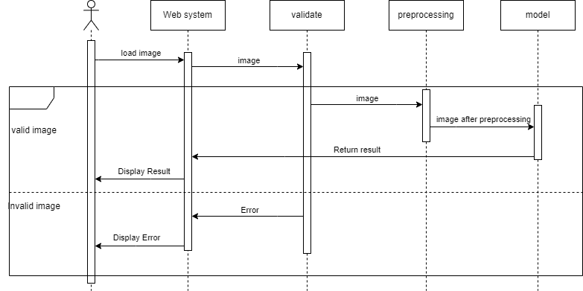
Sequence Diagram Detection steps

Slide 87

Profile editing

Slide 88

Deployment diagram

Slide 89

ERD diagram

Slide 90

Sitemap diagram
web platform

Slide 91

Mobile platform

Slide 92

block diagram

Slide 93


4.2) Applications
WWW.Rickman.com

Slide 94

4.2.1) Applications

Slide 95




Slide 96




Slide 97




Slide 98

4.2.2) Web Application

Slide 99

Login screen

Slide 100

Register Screen

Slide 101

Home Screen

Slide 102

About screen

Slide 103

Team screen

Slide 104

Services screen

Slide 105

Addition screen

Slide 106

Instructions screen

Slide 107

info screen

Slide 108

detect screen

Slide 109

Result screen

Slide 110
05
System Implementation

Slide 111

Visualization
we have 5,712 images in training file and divided into 4 files like below image

Slide 112

Visualization
we have 1,311 images in testing file and divided into 4 files like below image

Slide 113

Visualization
We will standardize the size of all images to 224*224

Slide 114

Classification
FITTING & TRAINING

Slide 115

Classification
Classification Model Evaluation

Slide 116


Classification
PREDICTION

Slide 117
Classification
Different models in classification
n | model | dataset | accuracy | output
1 | CNN | Have 3060 Images included in 3 files (yes (1500 image) , no(1500) , pred(60 images)) | 97.50% | (The image contains a brain tumor) OR (The image does not contain a brain tumor)
2 | KNN | Have 3060 Images included in 3 files (yes (1500 image) , no(1500) , pred(60 images)) | 94.17% | (The image contains a brain tumor) OR (The image does not contain a brain tumor)
3 | Random Forest | Have 3060 Images included in 3 files (yes (1500 image) , no(1500) , pred(60 images)) | 95.30% | (The image contains a brain tumor) OR (The image does not contain a brain tumor)
4 | CNN | have 7000 images included in 2 file every (training and testing) | 94.80% | (Glioma ,Meningioma ,no tumor, Pituitary)

Slide 118
Localization
VGG19 Unet
VGG19:
VGG19 is a convolutional neural network architecture that was proposed by the Visual Geometry Group at the University of Oxford. It's renowned for its simplicity and effectiveness. VGG19 consists of 19 layers, including convolutional layers with small 3x3 filters, max-pooling layers, and fully connected layers.

Slide 119
Localization
VGG19 Unet
U-Net:
U-Net is a convolutional neural network architecture designed for biomedical image segmentation tasks. It's characterized by a U-shaped architecture where the contracting path (encoder) captures context, and the expansive path (decoder) enables precise localization. Skip connections between the encoder and decoder paths facilitate the flow of high-resolution information.

Slide 120

Localization
VGG19 Unet
Combining these two architectures results in the VGG19 U-Net model, which leverages the powerful feature extraction capabilities of VGG19 along with the precise segmentation ability of U-Net. This model is particularly useful for tasks such as brain image segmentation, where accurately identifying different regions of the brain is crucial for diagnosis and analysis.

Slide 121

Localization
VISUALIZATION OF DATA

Slide 122

Localization
SEGMENTATION MODEL EVALUATION

Slide 123

Localization
VISUALIZATION PREDICTION

Slide 124

Localization
PREDICTION

Slide 125

Treatment
Challenge:
we haven't any dataset to make protocol model
Solution:

Slide 126
Treatment
Solution:
we searched about features that affect with direct form on protocol then make a correlation between them and select the best features
next step we going to use random data to generate some columns such as (level , Age , spread of tumor and type of tumor and previous treatment)
according to this features now we can assign the protocol for each case

Slide 127
Treatment
Dataset:
we have range of age between 1 to 70
range of level high and low
tumor type glioma , pituitary and meningioma (0,1,2)
spread of tumor yes or no (0,1)
previous treatment yes or no (0,1)

Slide 128
Treatment
After we have dataset ,now we will make a model after take age , level ,spread of tumor and type of tumor and previous treatment , the model we tell you the treatment

Slide 129
06
Dataset

Slide 130


Dataset Name :
Brain Tumor MRI Dataset
Dataset Structure :
Include 7,022 images
Extension JPG
Dataset Details :
The images are distributed to 10 folders Divided into:
Two folders
Training
Testing
Each folder contains 4 folders:
Glioma
Meningioma
Pituitary
No Tumor
Link : www.kaggle.com

Slide 131

Dataset Name :
Brain MRI segmentation
Dataset Structure :
Include 15,720 images
Extension TIF
Dataset Details :
The images are distributed to 10 folders Divided into:
Two folders
kaggle_3m
lgg-mri-segmentation
Link : www.kaggle.com

Slide 132
07
Future Work

Slide 133
7) Future Work
3D Dataset: make models with 3d dataset to make more accuracy
Exploring 3D convolutional neural networks (CNNs): Advancements in medical imaging technology and annotated brain tumor images can be leveraged to develop more sophisticated models that utilize volumetric information for accurate predictions.
Collaboration with medical professionals and institutions: Working closely with healthcare experts facilitates the collection of real-world brain tumor data, validating model performance and ensuring practical relevance.

Slide 134
08
Tools

Slide 135



8) Tools
Tools for mobile app :
Android Studio
Flutter
Dart

Slide 136




8) Tools
Tools for Web app :
VS Code
NumPy
Open CV
Keras + TensorFlow

Slide 137



8) Tools
Implementation tools:
Git
GitHub
Figma

Slide 138


8) Tools
Implementation tools:
Firebase
Flask

Slide 139
09
Conclusion

Slide 140
9) Conclusion
After this insightful and productive discussion, we find ourselves at a crucial juncture of this project. Data has been analyzed, conclusions drawn, and a foundational design laid out for the brain cancer detection application. This initial phase has provided us with a deeper understanding of the challenges ahead and ways in which we can overcome them.
It's evident that there are various technical and scientific challenges that demand our attention. Improving diagnostic accuracy, expanding the application scope, and ensuring reliability - all pose challenges that require creative thinking and ongoing effort.

Slide 141
9) Conclusion
However, this moment isn't the end of the project; it's a new beginning. We are now poised to embark on a fresh phase of work, where we'll take the necessary steps to achieve the highest standards in this application. We'll work fervently to serve the community and offer an effective solution for early brain cancer detection, aiming to reduce fatality rates and enhance healthcare quality.
So, we're primed and ready to transform this vision into a tangible reality. We'll continue to work with team spirit and dedication to accomplish our shared objectives. Thank you for your time and interest, and we look forward to the next steps in this inspiring journey

Slide 142
Thanks You

